Slide 1

investigating NYPD Historical Shooting Incidents
DTSA 5301
University of Colorado
April 1st, 2022

Slide 2
Objective:
Evaluate the demographics of historical shootings in the City of New York
Where do shootings occur?
How does the time of day affect the incident?
What is the age distribution of the perpetrators?
Is there a racial bias in these incidents?

Slide 3

Data import FEATURES
Location
Date
Time
Age
Gender
Race

Slide 4
Imported Data frame summary
Rows: 23,585
Columns: 19
INCIDENT_KEY <dbl> 24050482, 77673979, 203350417, 80584527, 90843~
OCCUR_DATE <chr> "08/27/2006", "03/11/2011", "10/06/2019", "09/~
OCCUR_TIME <time> 05:35:00, 12:03:00, 01:09:00, 03:35:00, 21:16~
BORO <chr> "BRONX", "QUEENS", "BROOKLYN", "BRONX", "QUEEN~
PRECINCT <dbl> 52, 106, 77, 40, 100, 67, 77, 81, 101, 106, 71~
JURISDICTION_CODE <dbl> 0, 0, 0, 0, 0, 0, 0, 0, 0, 0, 0, 0, 0, 0, 0, 0~
LOCATION_DESC <chr> NA, NA, NA, NA, NA, NA, NA, NA, NA, NA, NA, NA~
STATISTICAL_MURDER_FLAG <lgl> TRUE, FALSE, FALSE, FALSE, FALSE, FALSE, FALSE~
PERP_AGE_GROUP <chr> NA, NA, NA, NA, NA, NA, NA, NA, NA, NA, NA, NA~
PERP_SEX <chr> NA, NA, NA, NA, NA, NA, NA, NA, NA, NA, NA, NA~
PERP_RACE <chr> NA, NA, NA, NA, NA, NA, NA, NA, NA, NA, NA, NA~
VIC_AGE_GROUP <chr> "25-44", "65+", "18-24", "<18", "18-24", "<18"~
VIC_SEX <chr> "F", "M", "F", "M", "M", "M", "M", "M", "M", "~
VIC_RACE <chr> "BLACK HISPANIC", "WHITE", "BLACK", "BLACK", "~
X_COORD_CD <dbl> 1017542, 1027543, 995325, 1007453, 1041267, 10~
Y_COORD_CD <dbl> 255918.9, 186095.0, 185155.0, 233952.0, 157133~
Latitude <dbl> 40.86906, 40.67737, 40.67489, 40.80880, 40.597~
Longitude <dbl> -73.87963, -73.84392, -73.96008, -73.91618, -7~
Lon_Lat <chr> "POINT (-73.87963173099996 40.86905819000003)"~

Slide 5
Tidy data frame summary
Rows: 5,340
Columns: 18
INCIDENT_KEY <dbl> 16814011, 144732382, 68964080, 85875439, 17577~
OCCUR_DATE <date> 2006-06-13, 2015-07-23, 2009-12-17, 2012-07-2~
OCCUR_TIME <time> 20:56:00, 00:22:00, 13:45:00, 21:35:00, 03:40~
BORO <fct> BROOKLYN, BROOKLYN, MANHATTAN, BRONX, QUEENS, ~
PRECINCT <fct> 70, 90, 20, 42, 102, 73, 49, 73, 50, 40, 48, 4~
JURISDICTION_CODE <fct> 0, 2, 0, 2, 0, 0, 0, 0, 0, 2, 0, 2, 0, 2, 2, 2~
LOCATION_DESC <fct> MULTI DWELL - APT BUILD, MULTI DWELL - PUBLIC ~
STATISTICAL_MURDER_FLAG <fct> TRUE, FALSE, TRUE, FALSE, FALSE, FALSE, TRUE, ~
PERP_AGE_GROUP <fct> 25-44, 25-44, 25-44, <18, 25-44, <18, 18-24, 1~
PERP_SEX <fct> M, M, M, M, M, M, M, M, M, M, M, M, F, M, M, M~
PERP_RACE <fct> BLACK, WHITE HISPANIC, WHITE HISPANIC, BLACK, ~
VIC_AGE_GROUP <fct> 25-44, 25-44, 45-64, 25-44, 25-44, <18, 18-24,~
VIC_SEX <fct> M, M, F, M, F, F, M, M, M, M, M, M, M, M, M, M~
VIC_RACE <fct> BLACK, BLACK, WHITE HISPANIC, BLACK, AMERICAN ~
X_COORD_CD <dbl> 995793.0, 1001019.9, 990838.6, 1011046.7, 1031~
Y_COORD_CD <dbl> 173152.0, 196399.9, 225657.7, 239814.2, 190474~
Latitude <dbl> 40.64194, 40.70574, 40.78606, 40.82488, 40.689~
Longitude <dbl> -73.95841, -73.93952, -73.97621, -73.90318, -7~

Slide 6
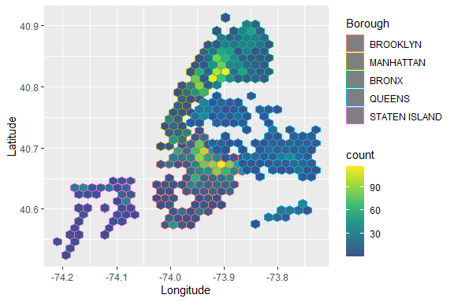
DENSITY OF SHOOTINGS
The Bronx, Brooklyn, and Manhattan have had most shootings.

Slide 7
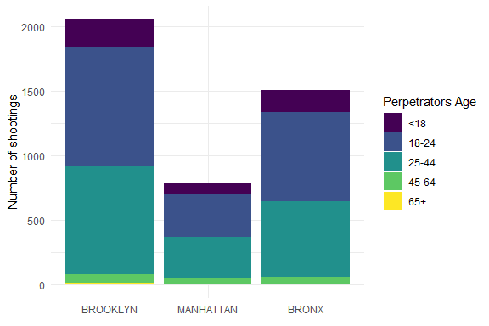
Age distribution of perpetrators
Most of the perpetrators are below the ages of 45.

Slide 8
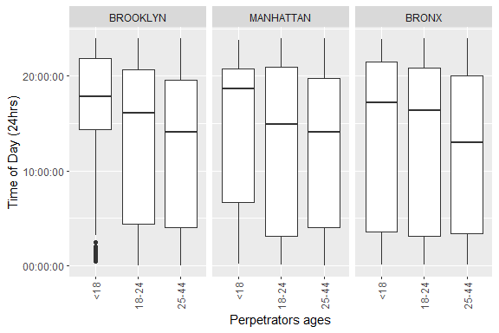
Time of SHOOTINGS
The older a perpetrator is, the earlier in the day a shooting will occur.

Slide 9
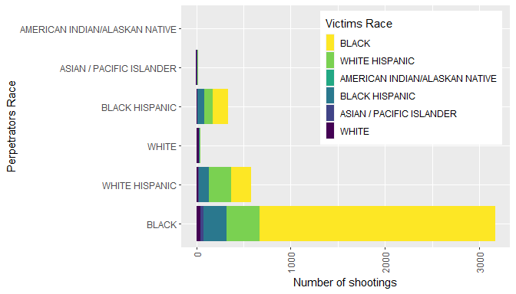
DYNAMICS OF RACE
The majority of shootings are occurring between Black people.

Slide 10
CONCLUSION
Most of the shootings have occurred between Black people who are under the age of 45 in the boroughs of the Bronx, Brooklyn, and Manhattan.

